Slide 1
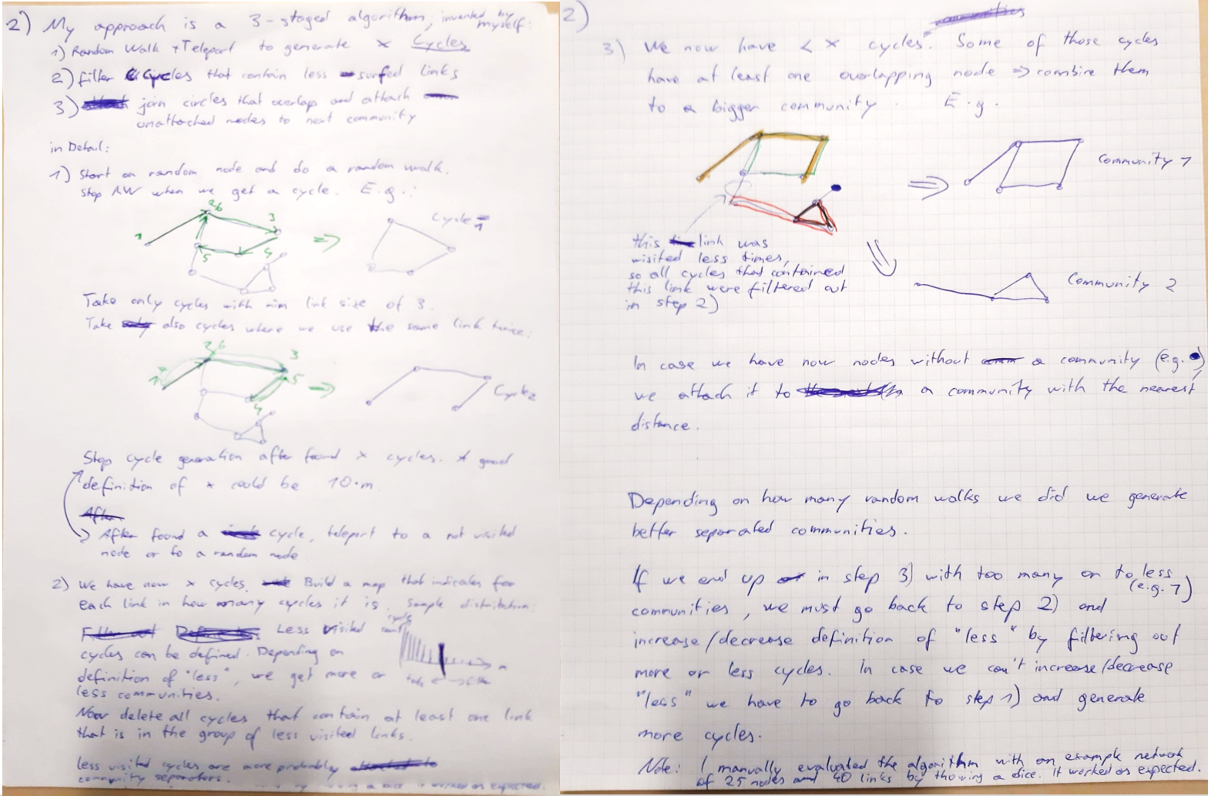
1. Motivation
NetSci HW3.2: extract communities from networks with random walk

Slide 2
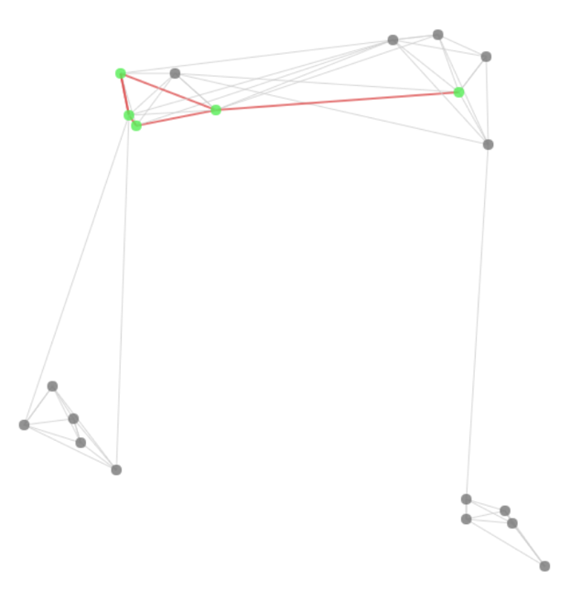
2. Methodology: JavaScript Algorithm Implementation
Generate Network with 50 – 5.000 nodes and connections
Coordinates and distance only for generation & visualization
Algorithm: Detect communities
Find circles
Measure connection usage in circles
Remove less used connections
→ Communities
Visualize and validate algorithm workflow via canvas
Measure runtime speed

Slide 3
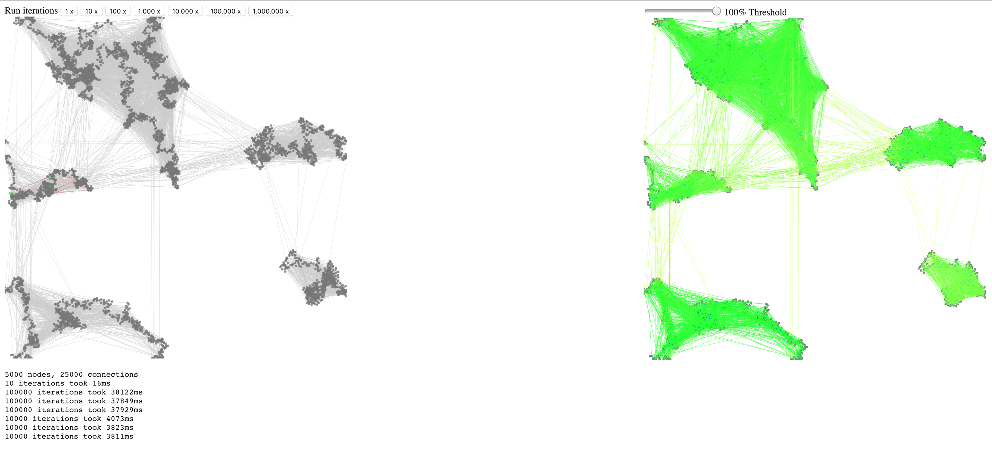
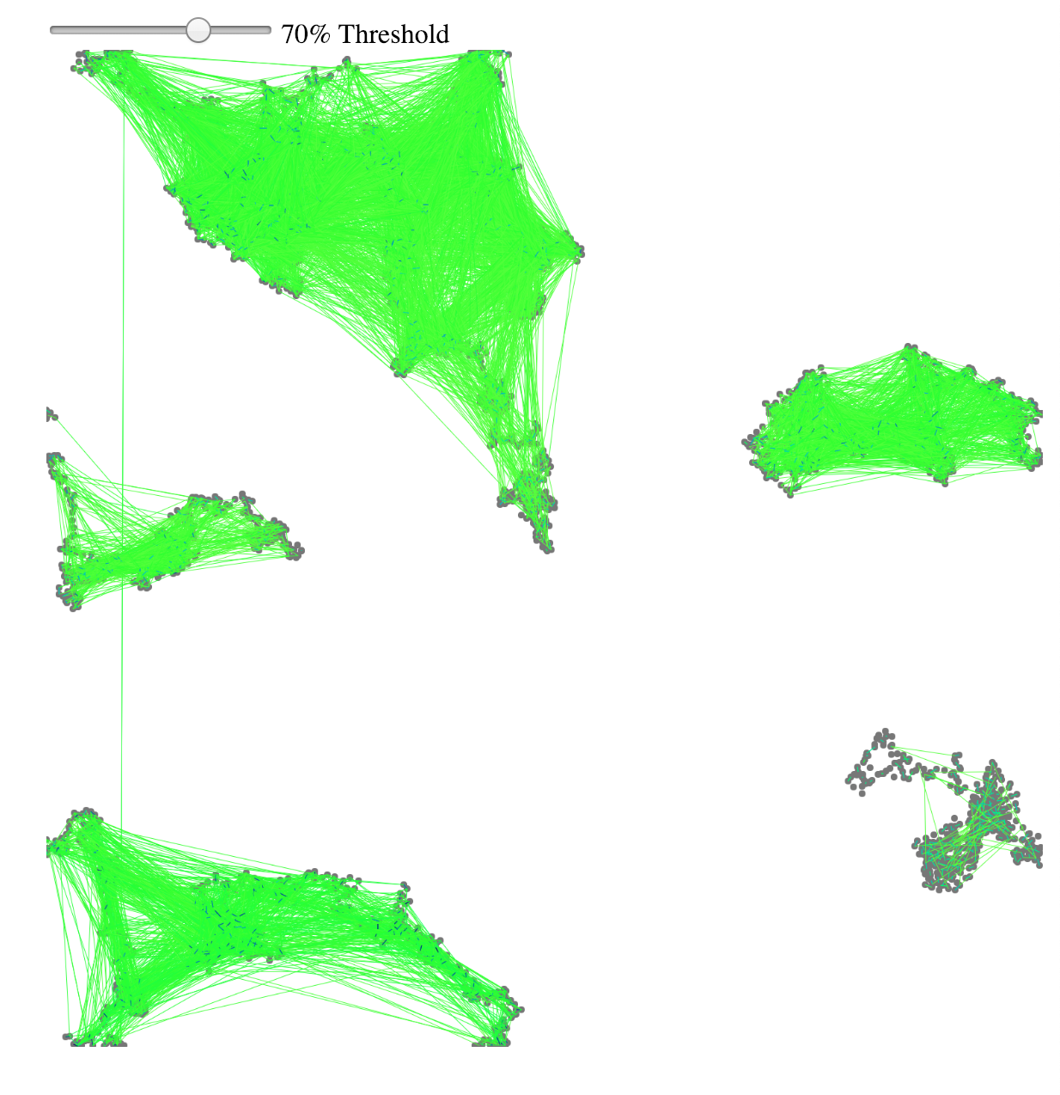
3. Experimental setup

Slide 4
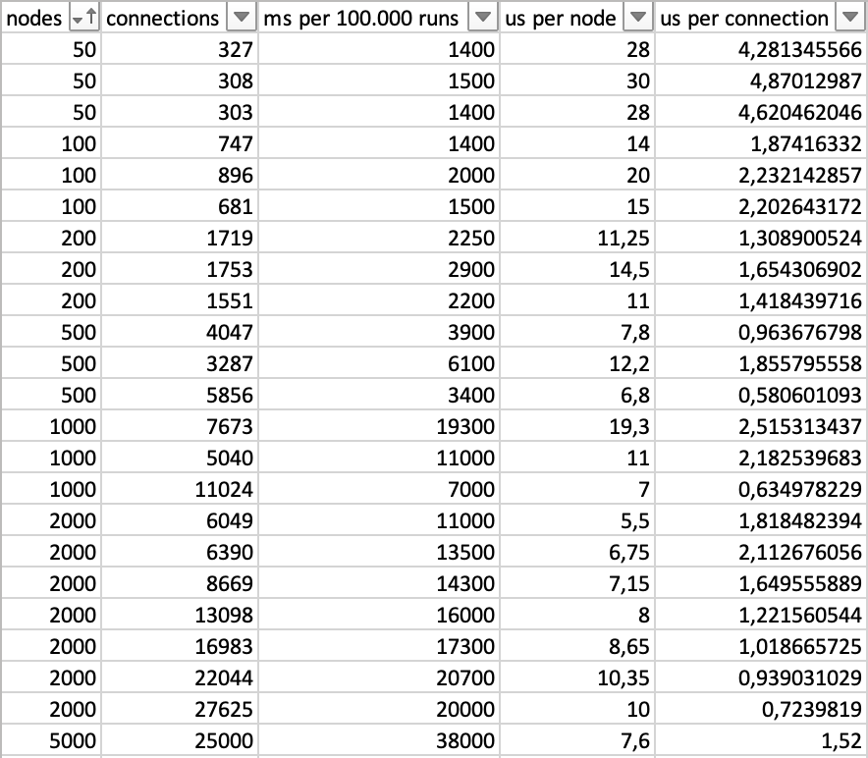
4. Results
Community detection is as expected, depends on generated network
Runtime Speed: On average O(nodeCount) and O(connectionCount) (?) Worst case: Infinity (random walk)

Slide 5
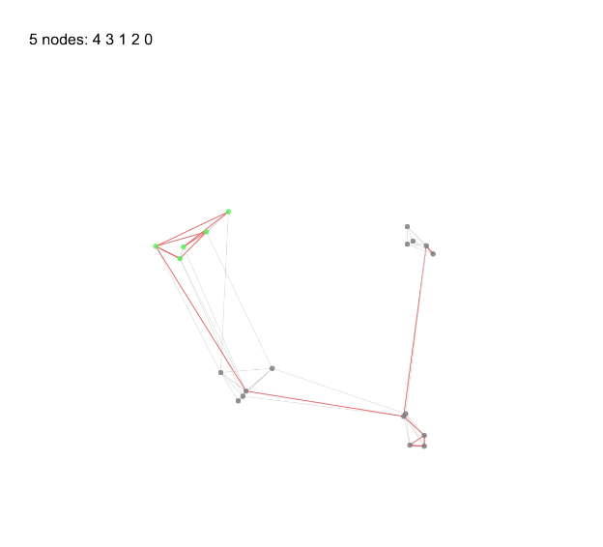
5. Discussion
Too fast to be good, probably measurement error or detection errors on too big networks
“Interesting” network generation was more complex than community detection
Simulation with “real” networks needed
Validation if “correct” communities are found
Postprocessing needed
Data structures and algorithm not optimized
Algorithm is very friendly to multithreading and can be executed distributed
Do you want to see the algorithm work? → Live Demo
Often nodes visited that don’t end up in a circle:
Green nodes: nodes in circle Gray nodes with red connection: visited before circle

